Slide 1
Probabilistic Model

Slide 2
Agenda
Introduction to probabilistic model
Building a model in Python
Solving Real World Problem
<number>
Notes:
<number>

Slide 3
Models
Modelling is a mathematically formalized way to approximate reality and optionally make predictions based on this approximation
Linear Model vs Exponential Model
y = mx + c vs y = ex
Discrete vs continuous model
Notes:
To Do: Rename to Establishing Business Context
<number>

Slide 4
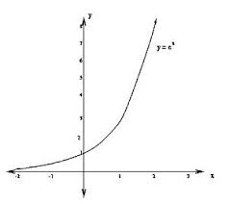
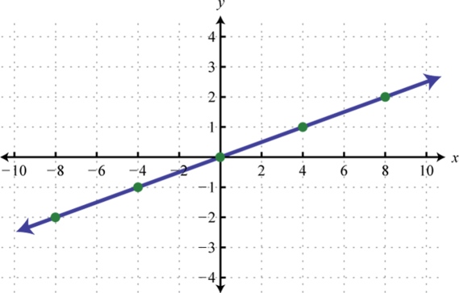
Linear vs Exponential
Vs
Notes:
<number>

Slide 5
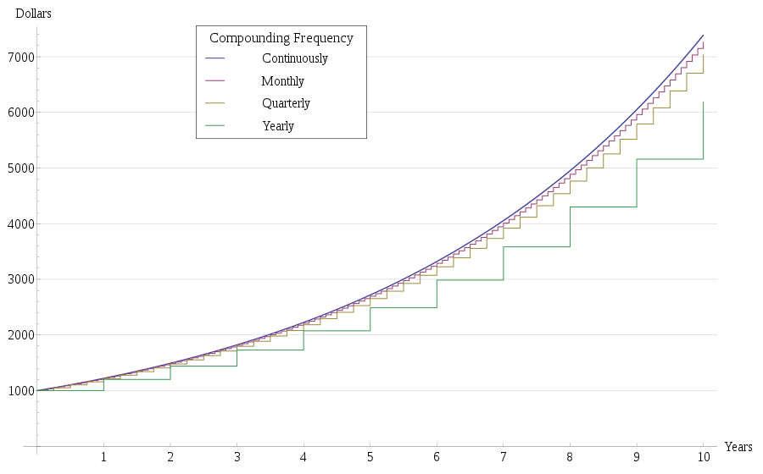
Continuous Vs Discrete
Notes:
<number>

Slide 6
Probability & Predictive Non Determinism
Probability is the quantifiable likelihood of the occurrence of an event
Probability fall on a scale between 0 (impossible) and 1(certain)
Probability comes into picture when our inability to make measurement of the physical world makes it impossible to make prediction of the future.
Things are not unpredictable, it looks unpredictable because we do not have enough information.
<number>
Notes:
<number>

Slide 7
Mean, Standard Deviation, Variance
Mean refers to the central value of a discrete set of numbers
Standard deviation is a measure that is used to quantify the amount of dispersion of a set of values
Variance is also a measure of how far a set of random value differ from their average
Notes:
<number>

Slide 8


What will be the result?
vs
<number>
Notes:
Let us suppose you flip a fair coin 50 times and get a tail all 50 times
Now if you were to flip it again another 50 times, what would be you guess on the number of heads and tails?
<number>

Slide 9
Regression To Mean
Gambler’s Fallacy
It is the belief that if an event occurs more frequent than normal during some period, it will happen less frequently in the future and vice versa.
If a variable is extreme the first time you measure, it will be closer to mean the next time you measure it.
A random variable that is outside the norm eventually tend to return to the norm to achieve this subsequent results will regress towards the mean.
Notes:
<number>

Slide 10
Probabilistic Model
Statistical analysis tool that estimates the probability of the occurrence of an event again on the basis of historical data
Notes:
<number>

Slide 11
MONTE CARLO SIMULATION
Notes:
Low: 1min
High: 3min
Positive Energy
Kick off ends on a high, with participants feeling positive about upcoming Inception, ability to get the right stuff done and excitement about collaboration.
Team Building
Core team have put down first stones in positive relationship. Participants have better understanding of each others goals, visions, constraints and are set up to work successfully together during Inception and beyond.
Shared Understanding
Shared understanding of project inception goals and approach
Understanding of participants, their roles, time and collaboration expectations
Understanding of the project vision put forward and initial scope of Inception. This will need at the very least validating in the next session, but people should walk out of the kick-off at least hearing the initial vision and problem definition, with what is in/out of scope for the Inception
Major Gaps Understood
Facilitator and team should be clear on areas where clarification is needed, or action needs to be taken. For instance, if there is a gap in client representation, if there are open questions on scope, or if there is not alignment on the vision or problem to be solved, these should be taken away and planned to clarify. This can happen through specific sessions, or just general actions on the side.
Clear next steps for Inception
Generally the schedule is reviewed during the Kick-off, but it’s important for people to know what the exact next steps are, i.e. we are going into the next session where we’re going to tackle Vision & Problem Definition, or other.
<number>

Slide 12
Monte Carlo Simulation gives all the possible outcomes of an uncertain event with the probability of occurrence of each outcome
This is a Stochastic process - a process in which the next state is depends on both the previous state and some random elements.
Today’s stock price = yesterday’s price *e
<number>
Notes:
<number>
Estimating the Work

Slide 13
BOLLINGER BANDS
Bollinger Band is an analysis tool which provides a technical trading strategy.
They provide relative definitions of high and low that can be used to formulate a trading approach
Bollinger band cannot be taken as a sole means to detect the bullish/bearish trend of the market.
It can be combined with other pattern recognition for better accuracy.
<number>
Notes:
<number>

Slide 14
cont..
Bollinger band has an upper and lower band which gives the range within which a stock will trade.
Upper Band = SMA + 2 * Std
Lower Band = SMA - 2* Std
<number>
Notes:
<number>

Slide 15
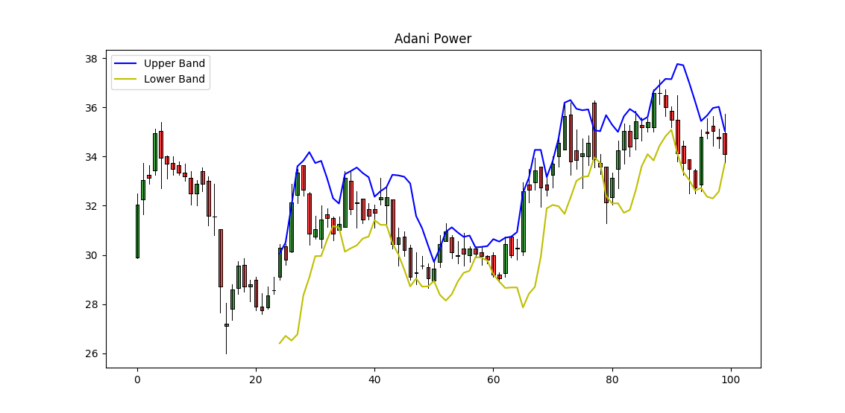
BBand chart of a Stock for 100 Trading days
<number>
Notes:
<number>

Slide 16
Monte Carlo Simulation in Stock Market
Periodic daily return = ln (day's price ÷ previous day's price)
Drift = average daily return - (variance ÷ 2)
random value = standard deviation * NORMSINV(RAND())
next day's price = today's price * e ^ (drift + random value)
<number>
Notes:
<number>

Slide 17
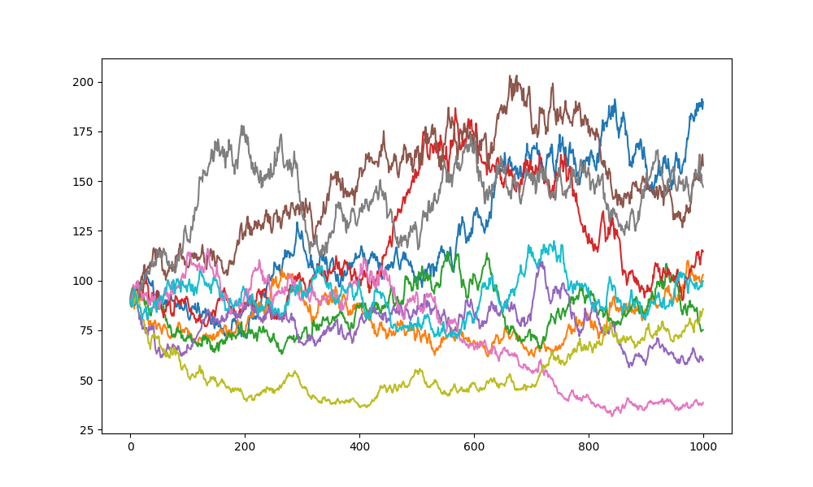
MCS of a Stock using 3years Trading Data
Notes:
<number>

Slide 18
References
https://www.youtube.com/watch?v=OgO1gpXSUzU&index=6&list=PLUl4u3cNGP619EG1wp0kT-7rDE_Az5TNd
https://github.com/mrjbq7/ta-lib
https://www.quandl.com/tools/python
https://www.coursera.org/learn/wharton-quantitative-modeling/lecture/MMEtB/3-5-monte-carlo-simulations
<number>
Notes:
<number>

Slide 19
QUESTIONS?

Slide 20
THANK YOU

